Slide 1









FOOD FOR THOUGHT
Priya M, Kasy T, Esther K , Susmitha V, Yash P

Slide 2







01
OBJECTIVES
Food accessibility, food options & where you go

Slide 3

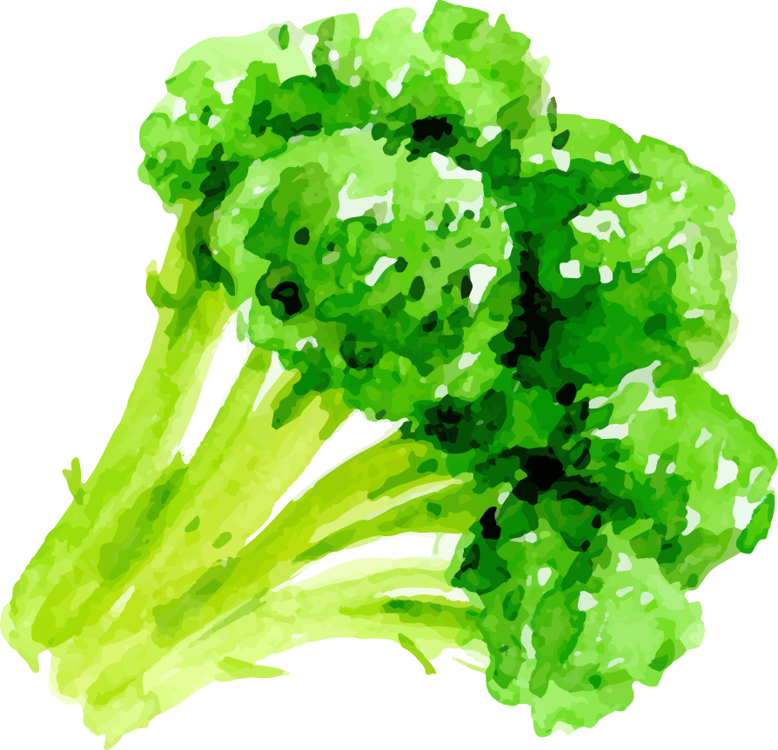

OBJECTIVES
Food Accessibility
Being ”Healthy”
Choices We Make
What does it mean for food to be accessible?
How does ”healthy” shape the way we categorize food?
How are our choices shaped by accessibility & health?

Slide 4
02
FOOD DESERTS
Food access

Slide 5
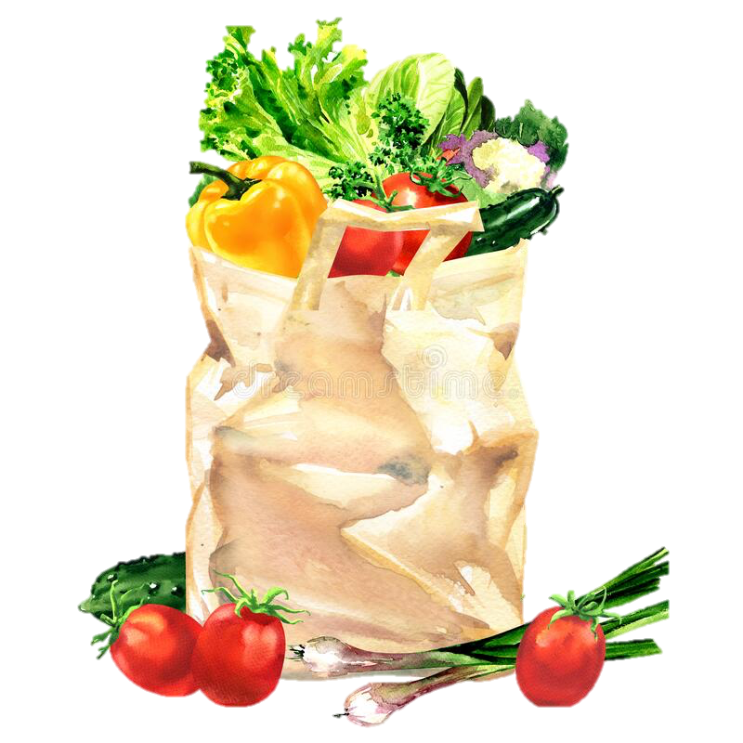
FOOD ACCESSIBILITY
Location
Vehicle Access
Cost
i.e. how far are you from supermarkets, grocery stores, etc.
i.e. what type of transportation is available
i.e. how affordable are the options closest to you
Notes:
Urban/Suburban/Rural
Whole Foods v FoodMaxx v Safeway v Farmers Market
Walkability v Public Transport v Car
Other categories could also be demographics, beyond the given radius of 1mile or 10miles respectively
Cost also factors in how many mouths to feed in a household or dietary need
Just because it’s walkable doesn’t mean it will always fit into the other two

Slide 6




FOOD DESERTS
USDA
living more than one mile from a supermarket in an urban/suburban area, and more than 10 miles from a supermarket in rural areas
37.78%
Of the population currently residing in food deserts based on the 2010 census
Notes:
Why could this be? What explains some of these numbers?
Food deserts do not necessarily have to do with living in an impoverished area – for example if you are living in the suburbs there may only really be a lot of housing wehre you live and you have to drive to get the groceries elsewhere, city planning makes a huge difference, certain grocery chains may choose to locate only in very specific areas based on local economics (wealthier areas, centralized, by other stores), hard to say whether it’s accounting for food delivery services or whether smaller/local markets may always be taken into consideration

Slide 7
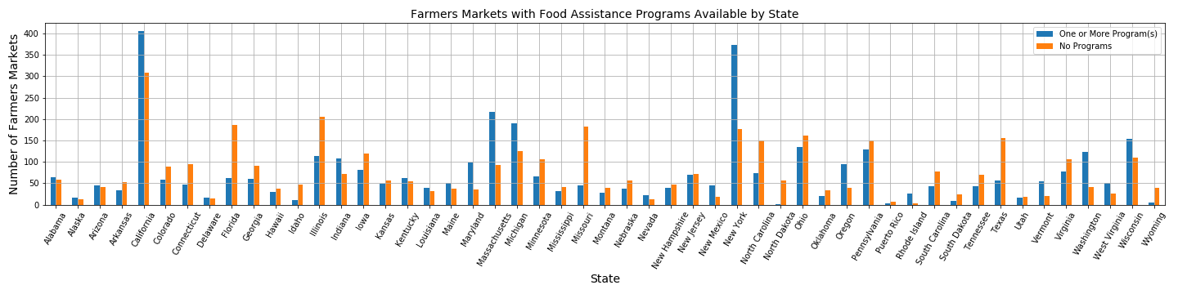


FARMERS MARKET
7,650
51.14%
48.86%
Total number of farmers markets registered in the U.S. and Puerto Rico
Of farmers markets do not have any food assistance programs
Of farmers markets have at least one or more food assistance programs
Notes:
Farmers markets – small businesses/farmers, may not even know that this an option, may not be fiscally sound for people who rely on these kind of food assistance programs, farmers markets may also be heavily artisanal as well – not always providing basic staples versus a WalMart where you can find a little bit of everything

Slide 8
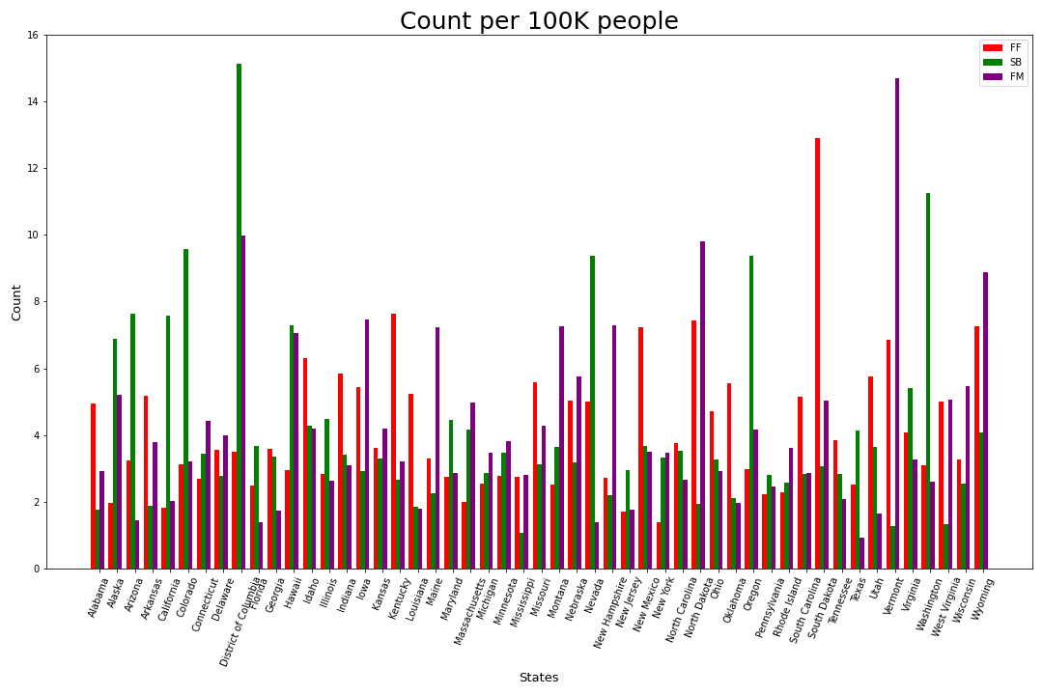

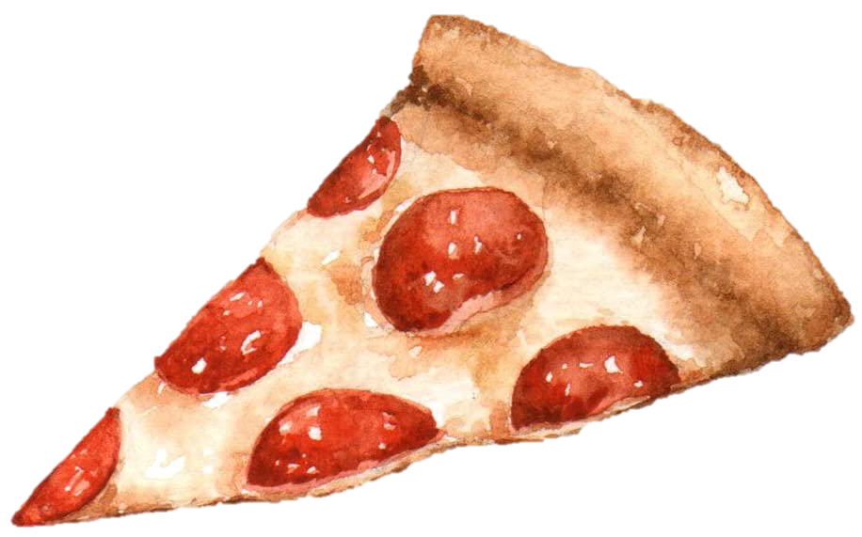
FOOD V FAST FOOD
Notes:
FF – total fast foods
SB – total Starbucks
FM – farmers’ markets

Slide 9
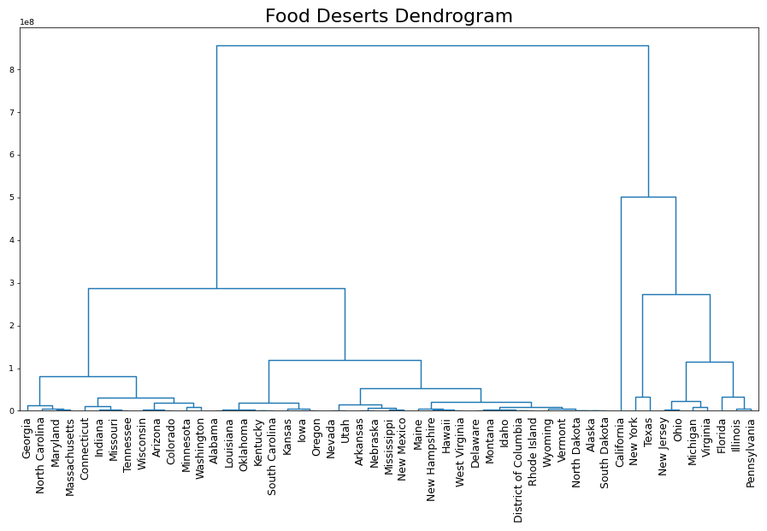

POPULATION RATIO CLUSTERED
Notes:
This chart provides visual representation of compounded correlation data between Median Household incomes by State and Ratio of total population in a food desert for the same state.

Slide 10
03
MAKING CHOICES
Figuring out the foods & recipes that work for you

Slide 11
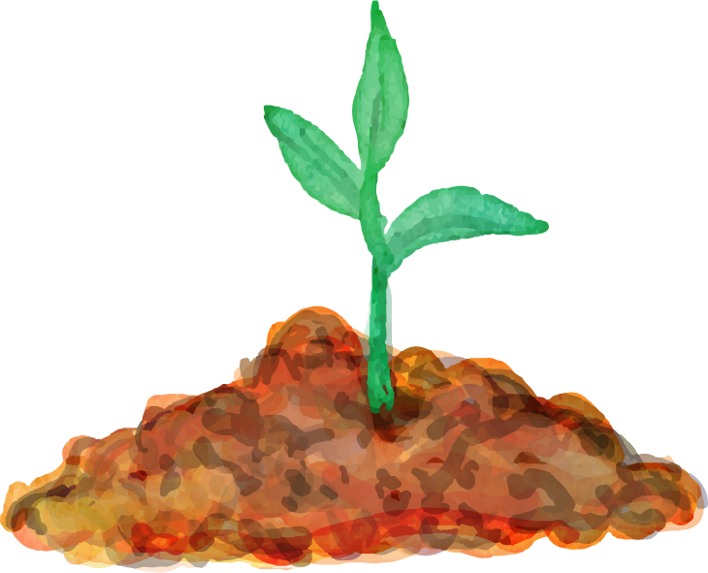


CHOICES
EATING IN
GOING OUT
“HEALTH”
Choosing to cook a meal at home
Fast food, restaurants, take out, instant foods, etc.
This can be very individual to your health goals or requirements

Slide 12
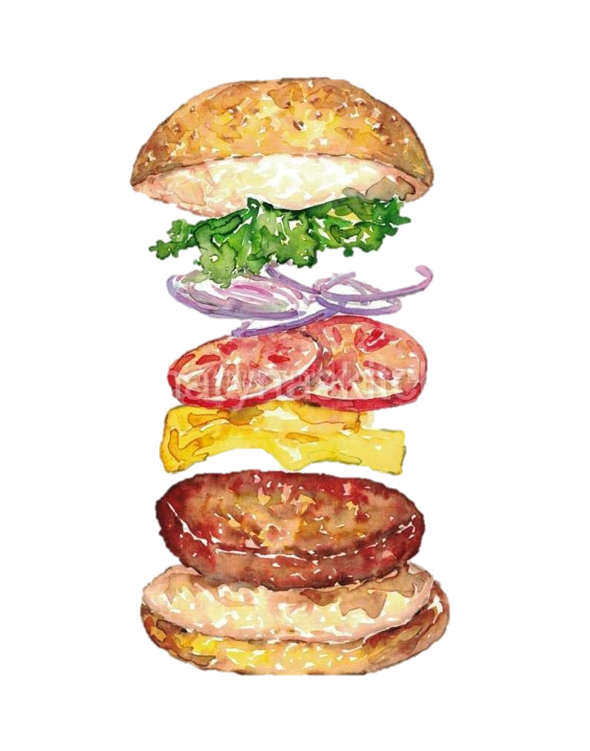
WELCOME TO MICKEY D’S
Categories
Nutritional Criteria
Breakfast
Beef & Pork
Chicken & Fish
Salads
Snacks & Sides
Desserts
Coffee & Tea
Beverages
Smoothies & Shakes
Calories
Sugars
Proteins
Carbs
Fats
Sodium
Fiber
Cholesterol
Vitamins

Slide 13
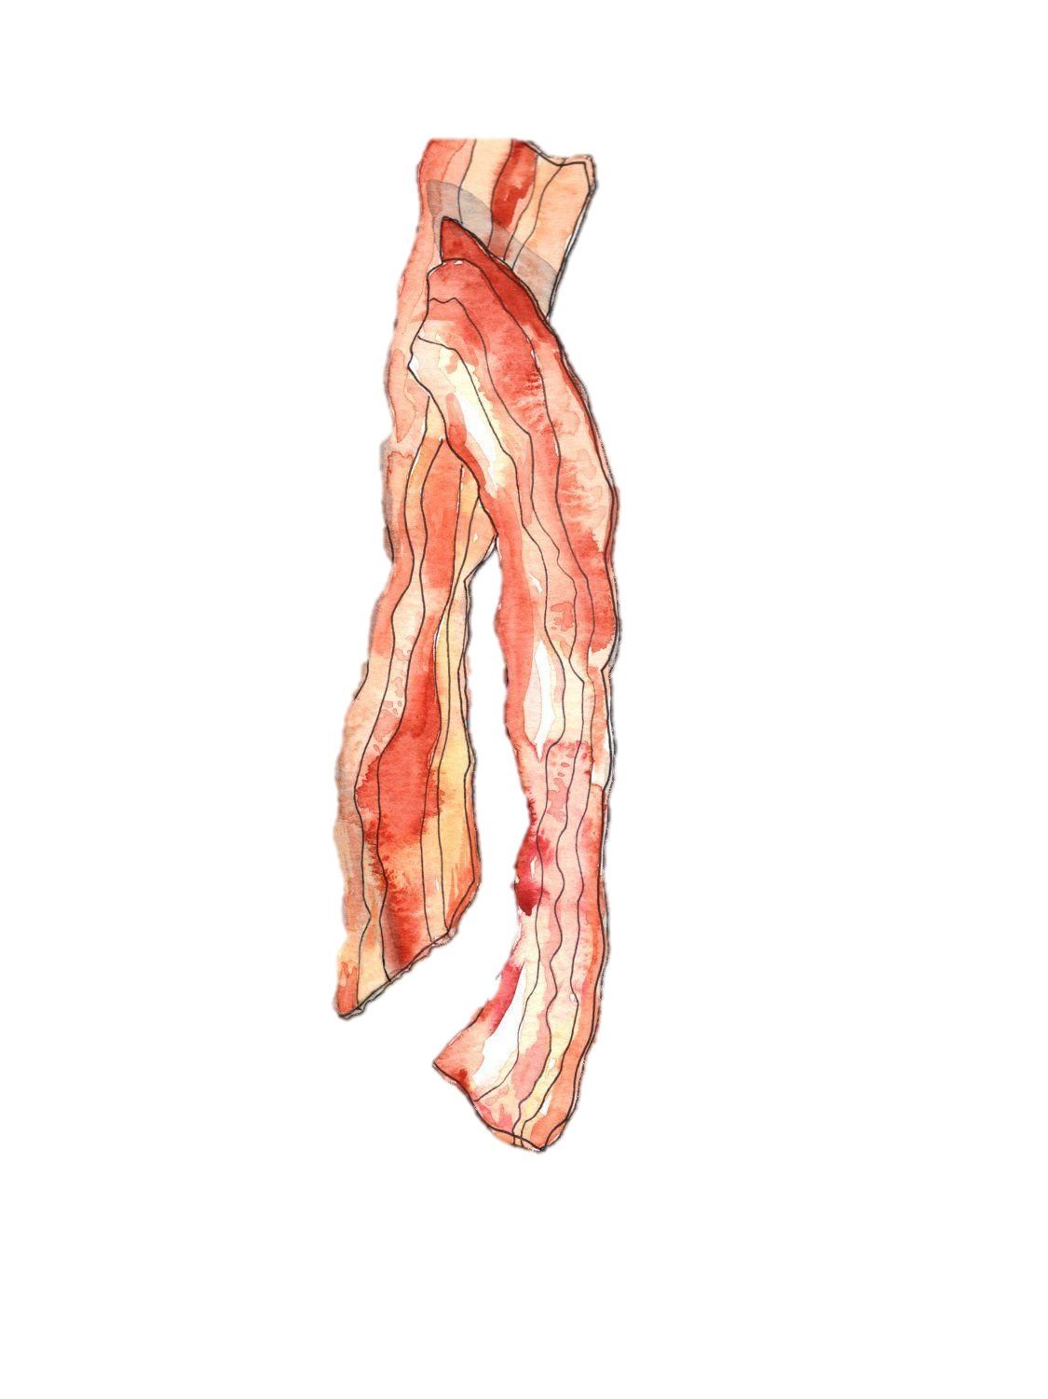

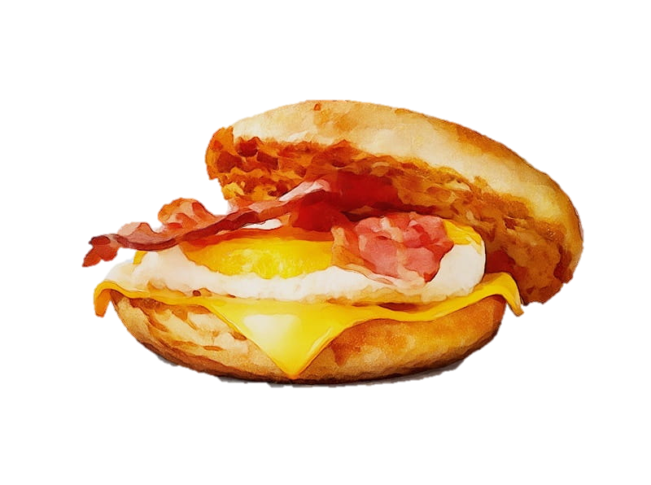
BREAKFAST UNDER 600 (C)
 | Menu Item | Calorie | Category
1 | Bacon Clubhouse Grilled Chicken Sandwich | 590 | Chicken & Fish
2 | Premium Grilled Chicken Classic Sandwich | 510 | Chicken & Fish
3 | Premium Crispy Chicken Classic Sandwich | 510 | Chicken & Fish
4 | Premium Grilled Chicken Ranch BLT Sandwich | 450 | Chicken & Fish
5 | Premium Grilled Chicken Classic Sandwich | 350 | Chicken & Fish

Slide 14




SOMETHING AT HOME
 | Menu Item | Calorie | Steps
1 | Best Grilled Pork Chops | 598 | 8
2 | Guinness Burgers | 597 | 7
3 | Best Ever Pumpkin Pie | 599 | 7
4 | 15 min Shrimp Scampi | 596 | 9
5 | French Toast Breakfast Sandwich | 596 | 7

Slide 15


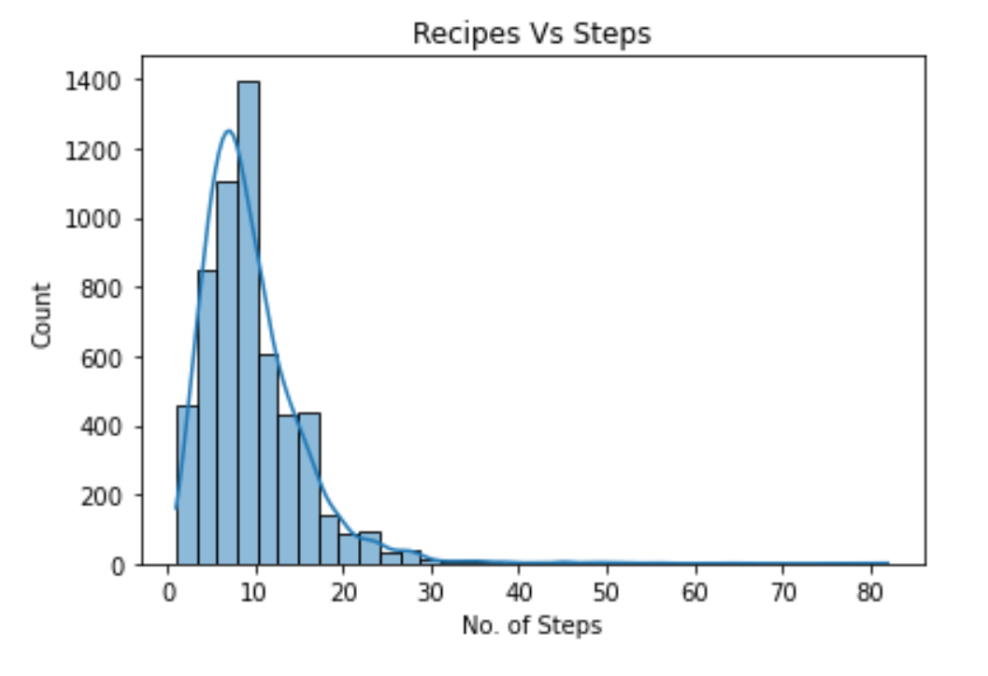
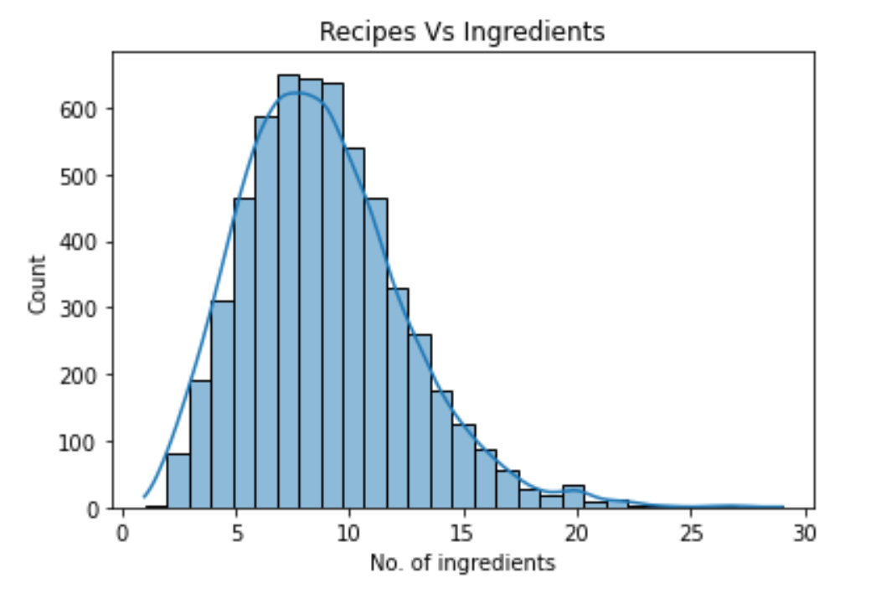
AS EASY AS 1, 2 … N
Average Steps & Ingredients
10

Slide 16
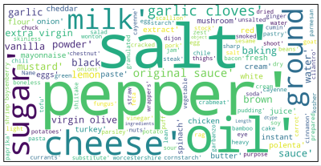
INGREDIENTS

Slide 17
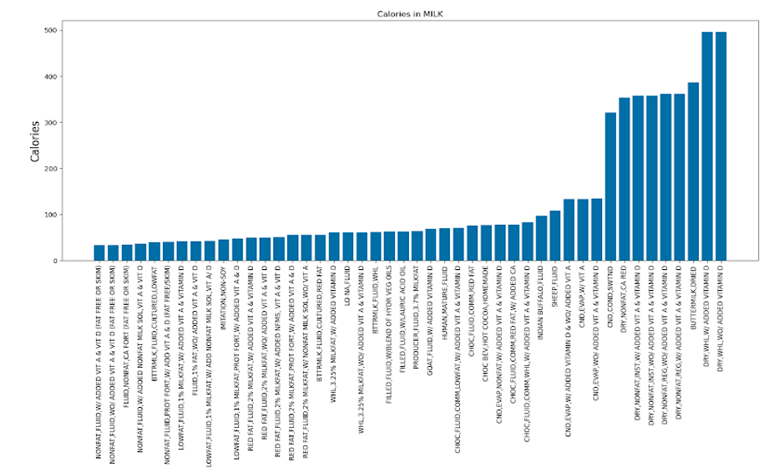

MILK

Slide 18
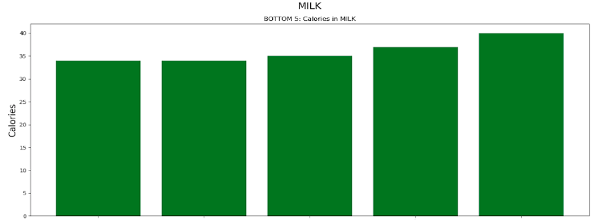

MILK

Slide 19
04
CAVEATS
Some things to consider about the data & our analysis

Slide 20

CAVEATS
#3
#2
# 4
#1
# 5
Using other fast food chains or restaurants
Breaking up food accessibility by urban/suburban/rural areas
No definitive categorization of recipes
Comparing food deserts in relation to specific supermarket chains
No details on serving sizes in the recipes

Slide 21
05
QUESTIONS
What else would you like to know?

Slide 22

RESOURCES
Data.gov Food Consumptions & Nutrient (Nutritional Information)
USDA Agricultural Marketing Service (Farmers Markets)
2010 Census & Food Access Research Atlas (Food Desert)
Food.com (Recipes)
McDonalds Website (McDonalds)

